Slide 1
Math 5389
Seminar in Probability and Statistics for Teachers
Probability
Notes:
1

Slide 2
Agenda
What is Probability?
Outcomes and Events
Basic Probability Rules
Conditional Probability and Independence
Multiplication Rules
Geometric Probability

Slide 3
What is Probability?

Slide 4
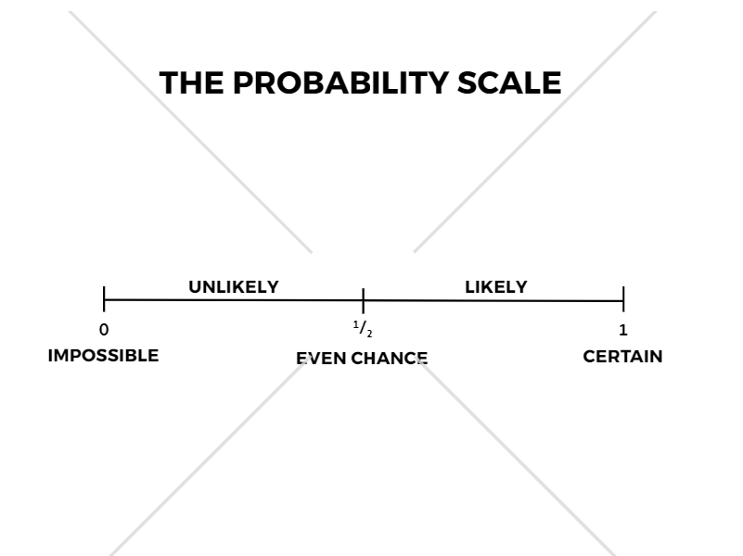
Probability
A number between 0 and 1 that characterizes the likelihood of some particular event happening.
Sometimes it is very easy to find the probability of an event and other times it is very difficult.

Slide 5
Why do we need to study probability?
Probabilities are a type of numerical way to make decisions.
Insurance companies, automobile manufacturers, pharmaceutical companies, teachers, and school-age children make decisions based on such data (e.g., whether or not you should take an umbrella).

Slide 6
Outcomes and Events

Slide 7
Terminology
An experiment is a chance process undertaken a large number of times, together with the results.
An outcome is a particular result of an experiment.
The set of all possible outcomes is called the sample space.
We use set notation to indicate these outcomes form a collections or set.
A subset of the sample space is referred to as an event. In other wards, an event is an outcome or set of outcomes of a designated types.
Example:
Experiment: Rolling a single number die.
Outcome: 4
Sample Space: {1, 2, 3, 4, 5, 6}
Event: Rolling an even number

Slide 8
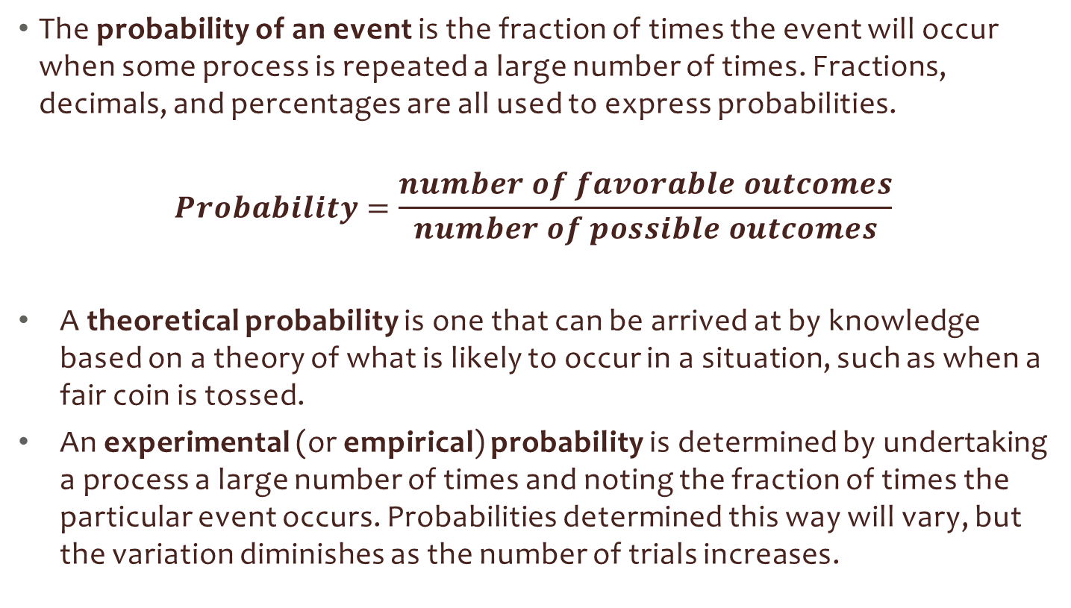
Methods of Assigning Probabilities
The probability of an event is the fraction of times the event will occur when some process is repeated a large number of times. Fractions, decimals, and percentages are all used to express probabilities.
$$Probability=\frac{number of favorable outcomes}{number of possible outcomes}$$
A theoretical probability is one that can be arrived at by knowledge based on a theory of what is likely to occur in a situation, such as when a fair coin is tossed.
An experimental (or empirical) probability is determined by undertaking a process a large number of times and noting the fraction of times the particular event occurs. Probabilities determined this way will vary, but the variation diminishes as the number of trials increases.

Slide 9
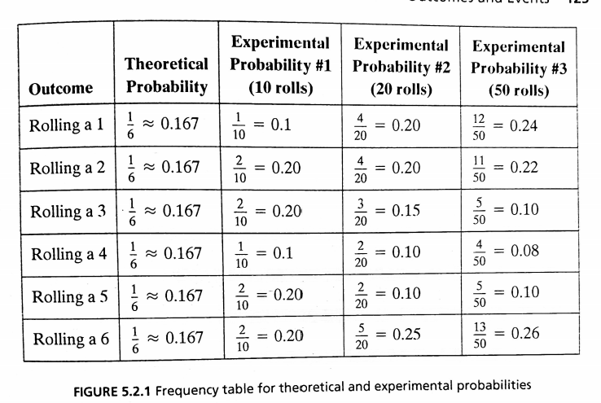
Law of Large Numbers
If we continue to conduct the experiment over and over and over again, the experimental probability will get closer and closer to the theoretical probability. This is exactly the idea of a limit from Calculus!

Slide 10
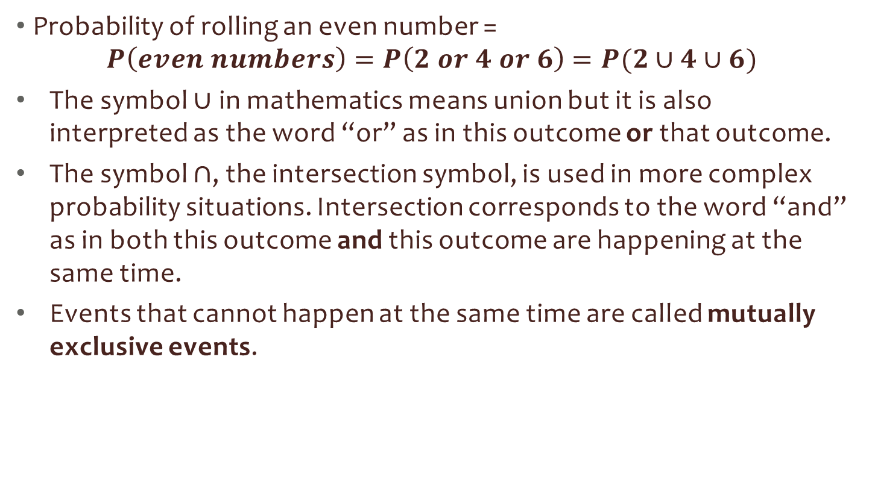
Notation
Probability of rolling an even number =
$$P\left(even numbers\right)=P\left(2 or 4 or 6\right)=P(2∪4∪6)$$
The symbol $∪$ in mathematics means union but it is also interpreted as the word “or” as in this outcome or that outcome.
The symbol $∩$, the intersection symbol, is used in more complex probability situations. Intersection corresponds to the word “and” as in both this outcome and this outcome are happening at the same time.
Events that cannot happen at the same time are called mutually exclusive events.

Slide 11
Basic Probability Rules

Slide 12

Probability Rule #1
All probabilities must be no less than zero and no greater than one. Using “E” to stand for a particular event, in probability notation we have:
$$0≤P(E)≤1$$

Slide 13

Probability Rule #2
The sum of all the probabilities of the individual (and mutually exclusive) outcomes in a sample space must add to 1.
$$∑P\left(all outcomes\right)=1$$

Slide 14
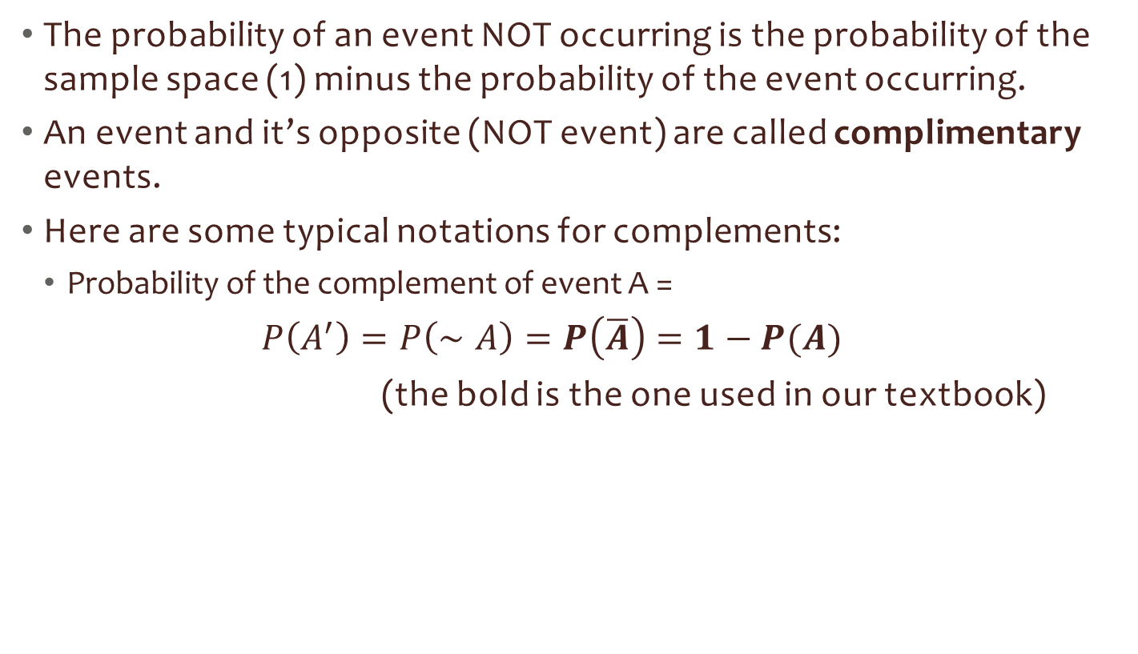
Probability Rule #3
The probability of an event NOT occurring is the probability of the sample space (1) minus the probability of the event occurring.
An event and it’s opposite (NOT event) are called complimentary events.
Here are some typical notations for complements:
Probability of the complement of event A =
$P\left(A^{′}\right)=P\left(∼A\right)=P\left(\overline{A}\right)=1−P(A)$
(the bold is the one used in our textbook)

Slide 15
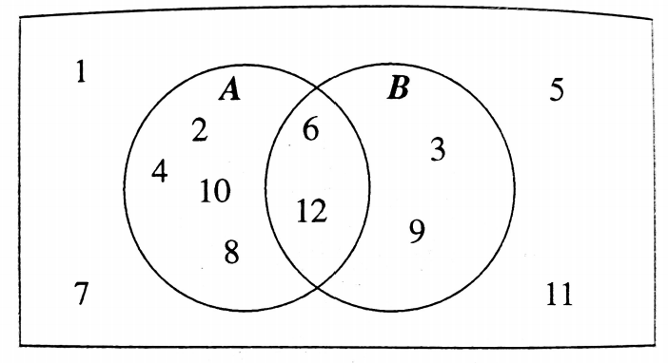
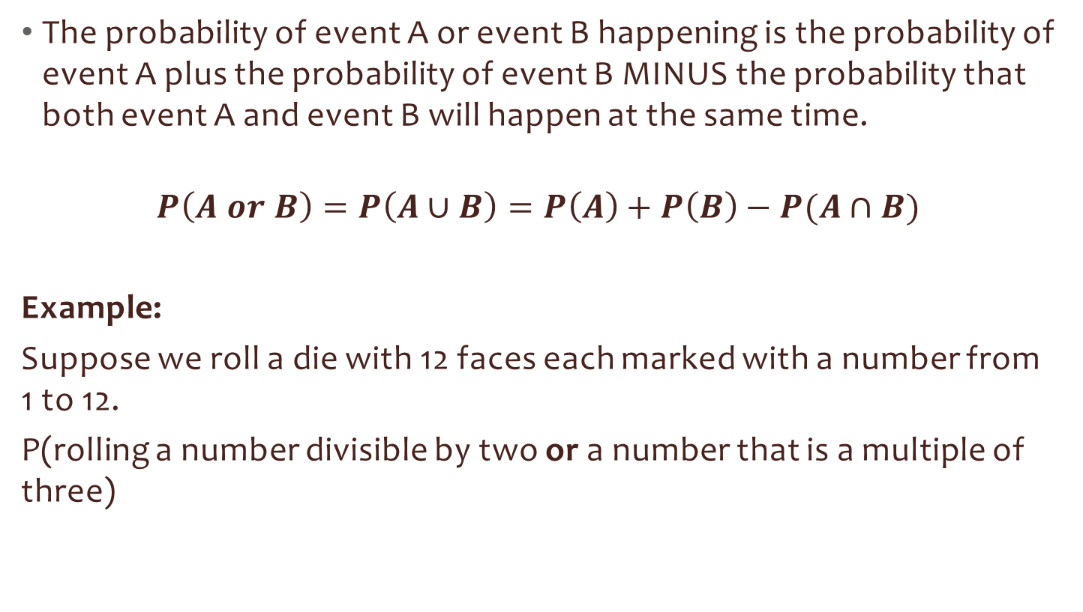
Probability Rule #4
The probability of event A or event B happening is the probability of event A plus the probability of event B MINUS the probability that both event A and event B will happen at the same time.
$$P\left(A or B\right)=P\left(A∪B\right)=P\left(A\right)+P\left(B\right)−P(A∩B)$$
Example:
Suppose we roll a die with 12 faces each marked with a number from 1 to 12.
P(rolling a number divisible by two or a number that is a multiple of three)

Slide 16
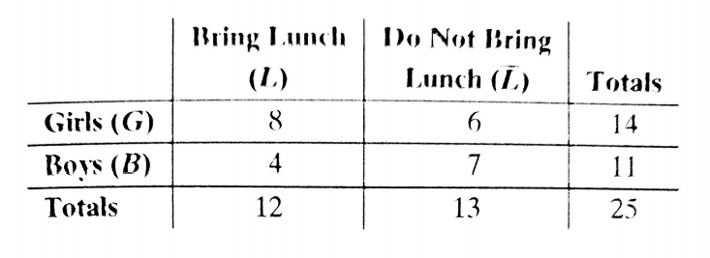
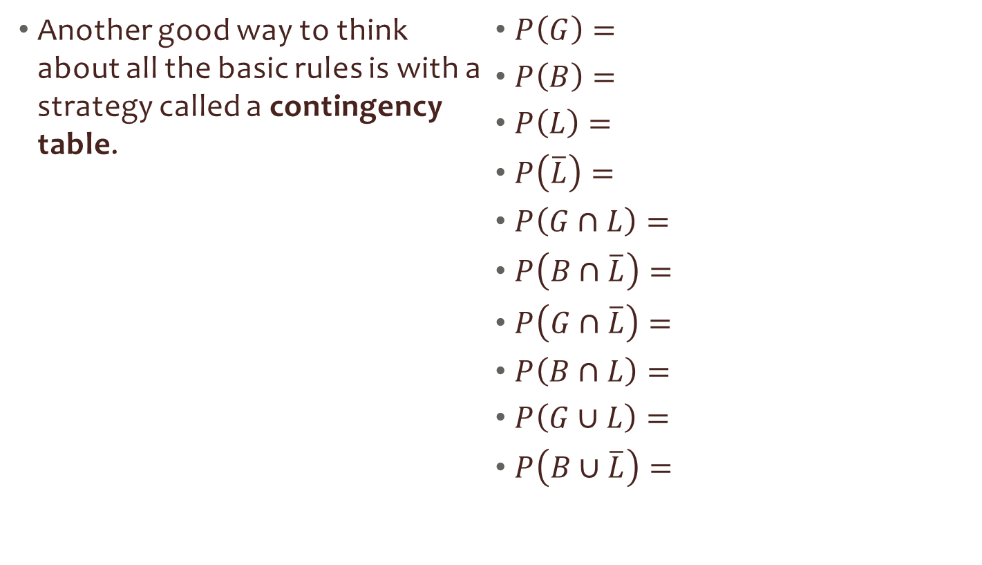
Contingency Table
Another good way to think about all the basic rules is with a strategy called a contingency table.
$P\left(G\right)=$
$P\left(B\right)=$
$P\left(L\right)=$
$P\left(\overline{L}\right)=$
$P\left(G∩L\right)=$
$P\left(B∩\overline{L}\right)=$
$P\left(G∩\overline{L}\right)=$
$P\left(B∩L\right)=$
$P\left(G∪L\right)=$
$P\left(B∪\overline{L}\right)=$

Slide 17
Conditional Probability and independence

Slide 18

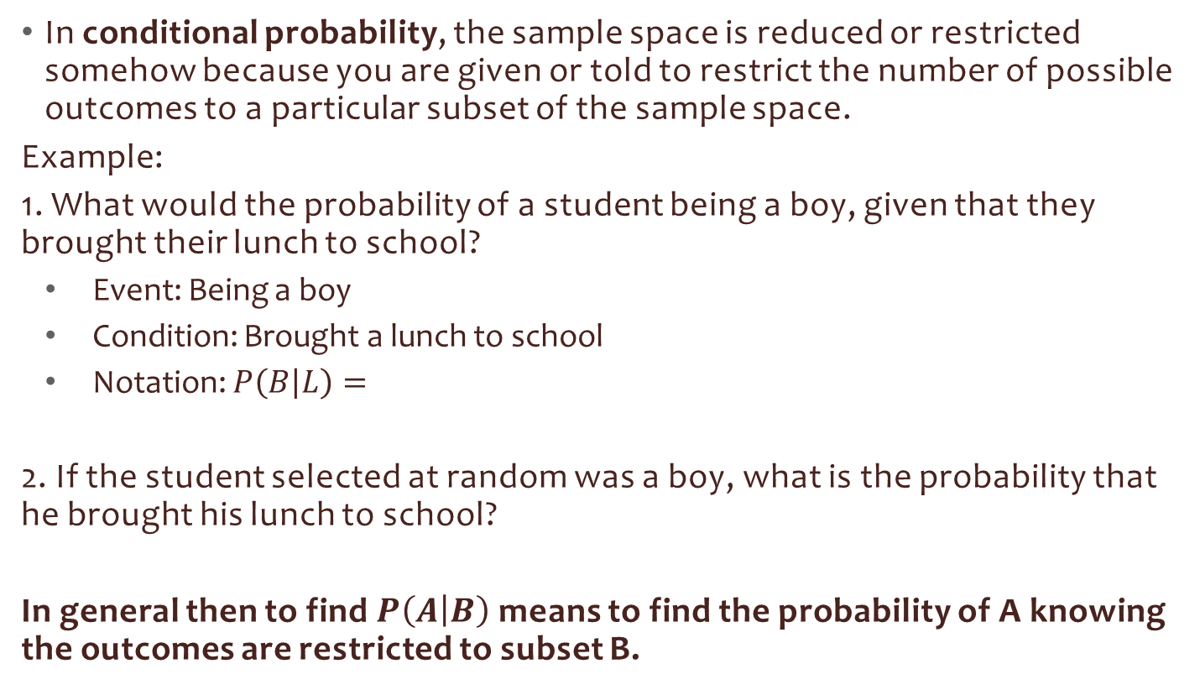
Conditional Probabilities
In conditional probability, the sample space is reduced or restricted somehow because you are given or told to restrict the number of possible outcomes to a particular subset of the sample space.
Example:
1. What would the probability of a student being a boy, given that they brought their lunch to school?
Event: Being a boy
Condition: Brought a lunch to school
Notation: $P\left(B | L\right)=$
2. If the student selected at random was a boy, what is the probability that he brought his lunch to school?
In general then to find $P\left(A | B\right)$ means to find the probability of A knowing the outcomes are restricted to subset B.

Slide 19

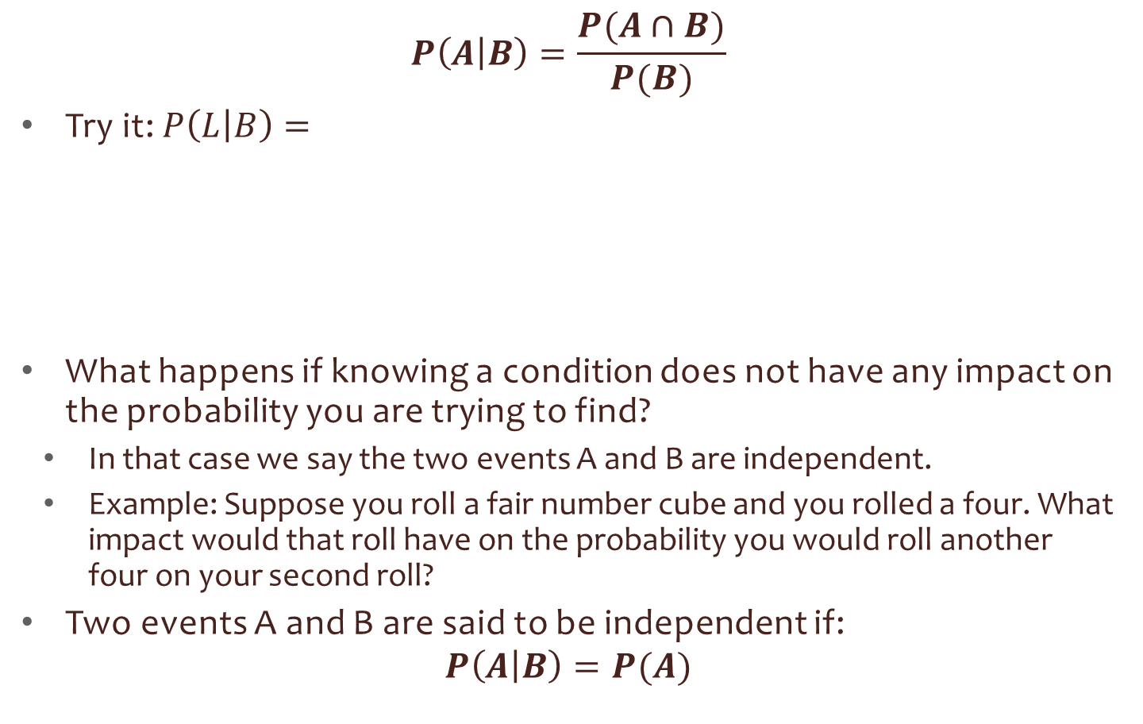
Probability Rule #5: Conditional Probability Rule
$$P\left(A | B\right)=\frac{P(A∩B)}{P(B)}$$
Try it: $P\left(L | B\right)=$
What happens if knowing a condition does not have any impact on the probability you are trying to find?
In that case we say the two events A and B are independent.
Example: Suppose you roll a fair number cube and you rolled a four. What impact would that roll have on the probability you would roll another four on your second roll?
Two events A and B are said to be independent if:
$$P\left(A | B\right)=P(A)$$

Slide 20
Multiplication rules

Slide 21
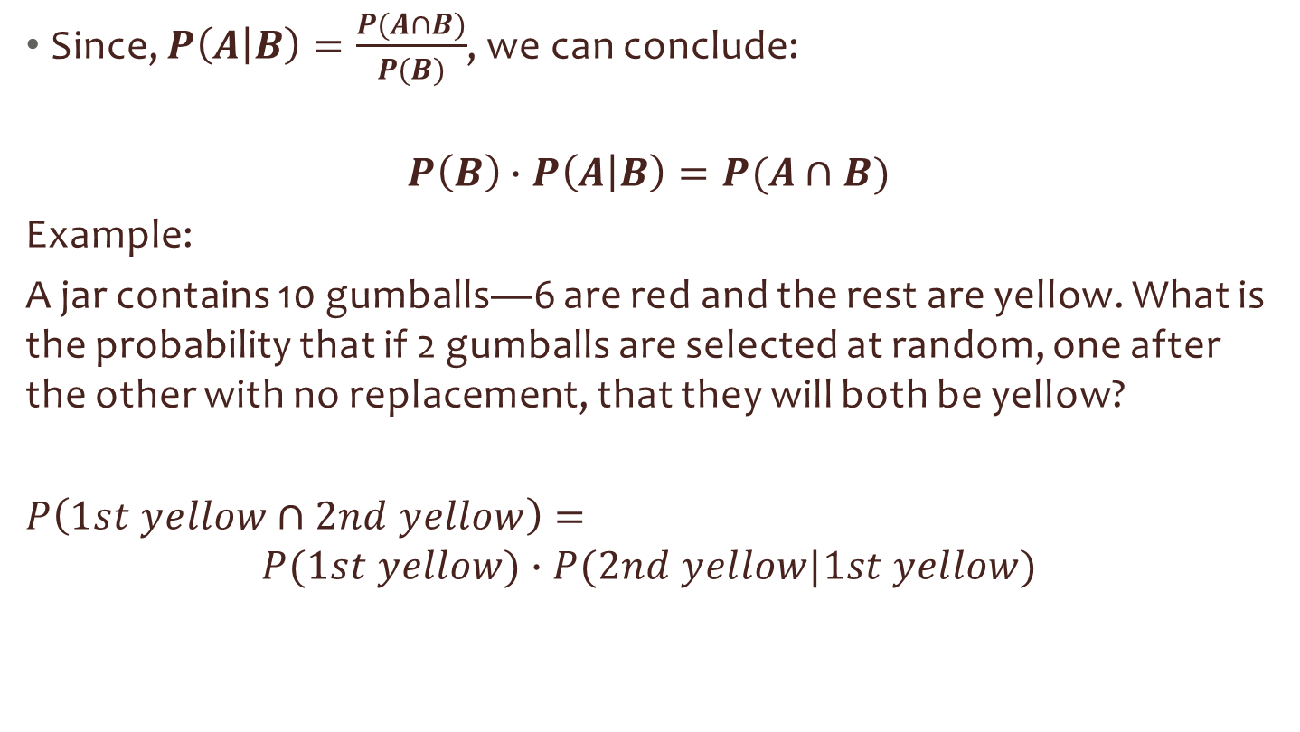
Probability Rule #6: Multiplication Rule
Since, $P\left(A | B\right)=\frac{P(A∩B)}{P(B)}$, we can conclude:
$$P\left(B\right)∙P\left(A | B\right)=P(A∩B)$$
Example:
A jar contains 10 gumballs—6 are red and the rest are yellow. What is the probability that if 2 gumballs are selected at random, one after the other with no replacement, that they will both be yellow?
$P\left(1st yellow∩2nd yellow\right)=$
$$P(1st yellow)∙P(2nd yellow|1st yellow)$$

Slide 22
Geometric Probability

Slide 23
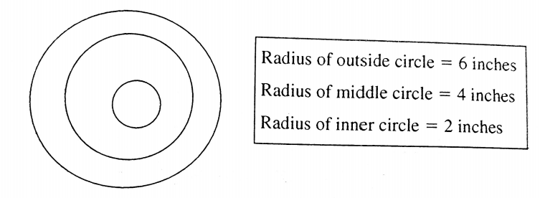
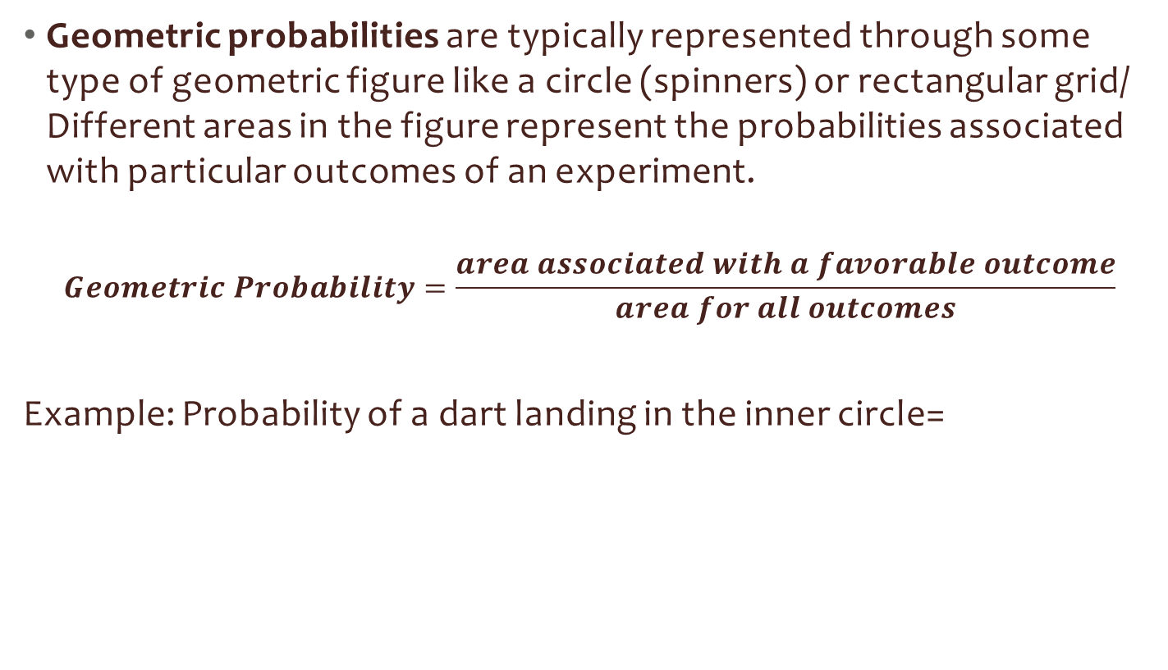
Geometric Probability
Geometric probabilities are typically represented through some type of geometric figure like a circle (spinners) or rectangular grid/ Different areas in the figure represent the probabilities associated with particular outcomes of an experiment.
$$Geometric Probability=\frac{area associated with a favorable outcome}{area for all outcomes}$$
Example: Probability of a dart landing in the inner circle=

